Slide 1

Audio ML: Urban Soundscape Classification
Submitted By :
Biswaranjan Chakra (CSE-A2, SIC:- 23BCSE94, Roll no.:- 04)
Debi Prasad Dhal (CSE-A2, SIC:- 23BCSB44, Roll no.:- 17)
Asim Anshuman Sahoo (CSE-A1, SIC:- 23BCSF93, Roll no.:- 19)
Satyam Das (CSE-A1, SIC:- 23BCSF75, Roll no.:- 22)

Slide 2
Introduction
Urban areas produce a wide range of environmental sounds — from traffic and construction to human activities.
Recognizing and understanding these sound patterns is crucial for developing smart city applications, noise pollution management, and urban monitoring systems.
The project “Audio ML: Urban Soundscape Classification” aims to build an intelligent machine learning model capable of identifying and categorizing different urban sounds automatically.

Slide 3
Background of the Study
Reference (Year) | Background Study | Models Used | Shortcoming
1. Mushtaq & Su (2020) | Worked on environmental sound classification using enhanced spectrogram features. | Feature-based ML/DL methods. | Limited generalization across diverse noise environments.
2. Das, Chakrabarty & Piran (2021) | Used CNN for environmental sound recognition with improved loss functions. | Convolutional Neural Network (CNN). | Performance drops with complex or overlapping urban sounds.
3. McFee et al. (2015) | Proposed a temporal–frequency attention-based CNN for sound classification. | Attention-based CNN. | High computational cost; may not suit real-time use.

Slide 4
Problem Statement
Urban noise levels are rising quickly due to traffic, construction, and dense population activities. As cities continue to grow, the need to understand and manage these diverse sound environments has become more important than ever.
Traditional methods of identifying sound sources rely heavily on manual monitoring, which is time-consuming, inconsistent, and not scalable for large urban areas. Existing systems also lack smart, automated capabilities to classify different types of sounds accurately.
To address these gaps, machine learning and deep learning–based solutions are essential. They enable real-time, automated, and highly accurate recognition of urban sound events, ensuring consistent monitoring and improved decision-making for smart city applications.

Slide 5
Objective
Sl. No. | Objective Description
1 | Develop a system that classifies urban environmental sounds automatically.
2 | To preprocess and extract meaningful features from raw audio using Python libraries such as Librosa.
3 | To train and evaluate classification models using frameworks like Keras and PyTorch.
4 | Implement and compare ANN and CNN models. Extract meaningful acoustic features using MFCCs and spectrograms.
5 | To enable applications in noise pollution monitoring, smart city analytics, and urban event detection.

Slide 6
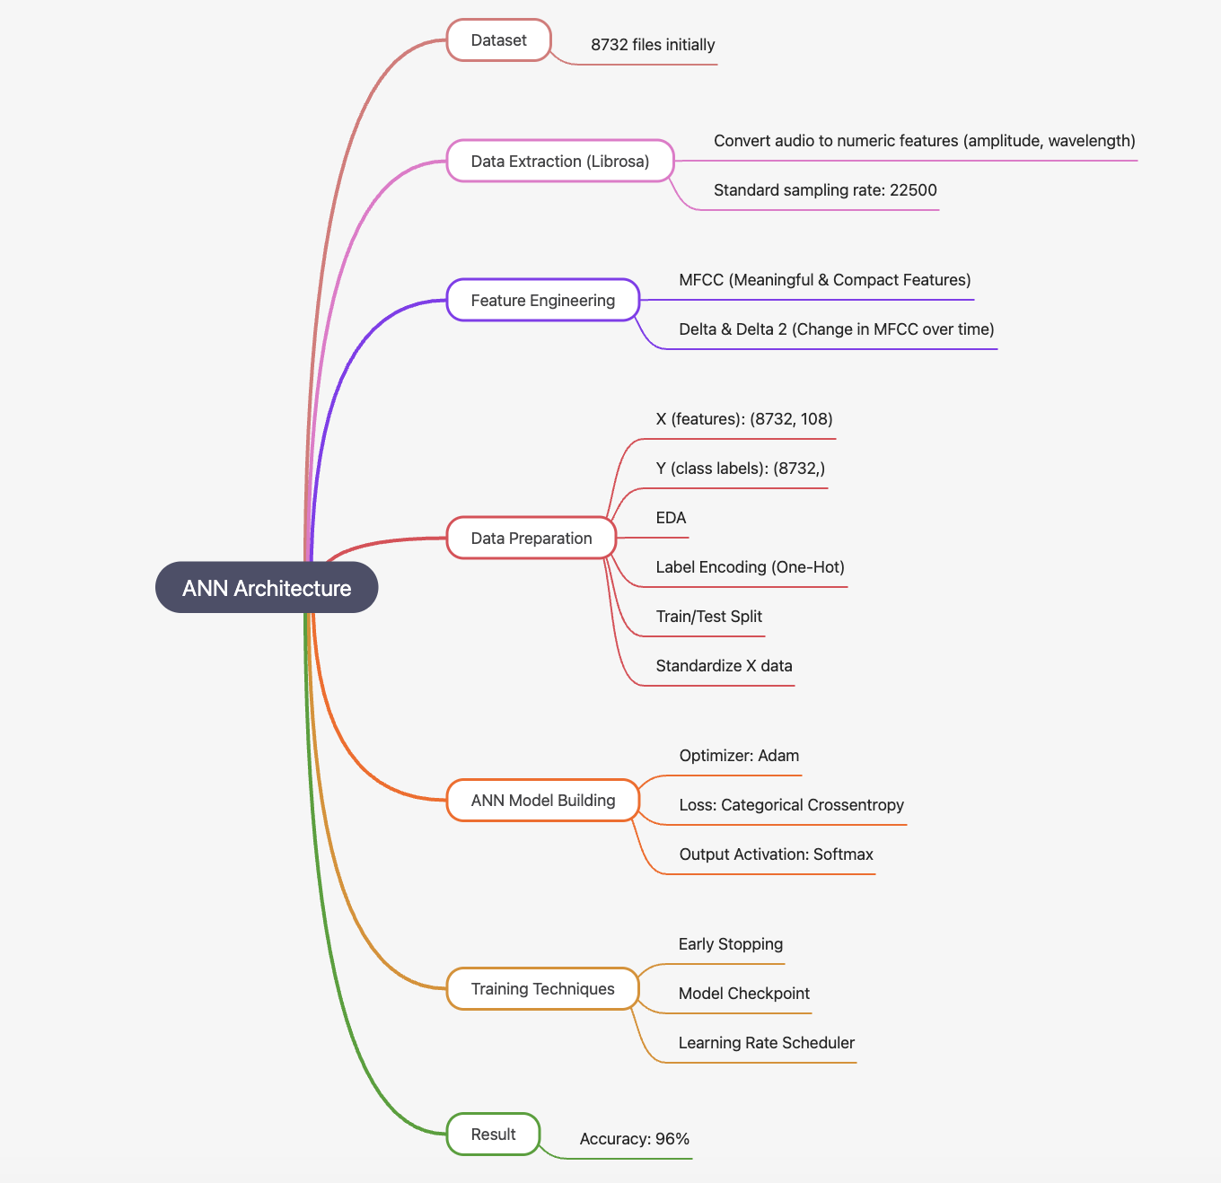
Work Flow Diagram

Slide 7
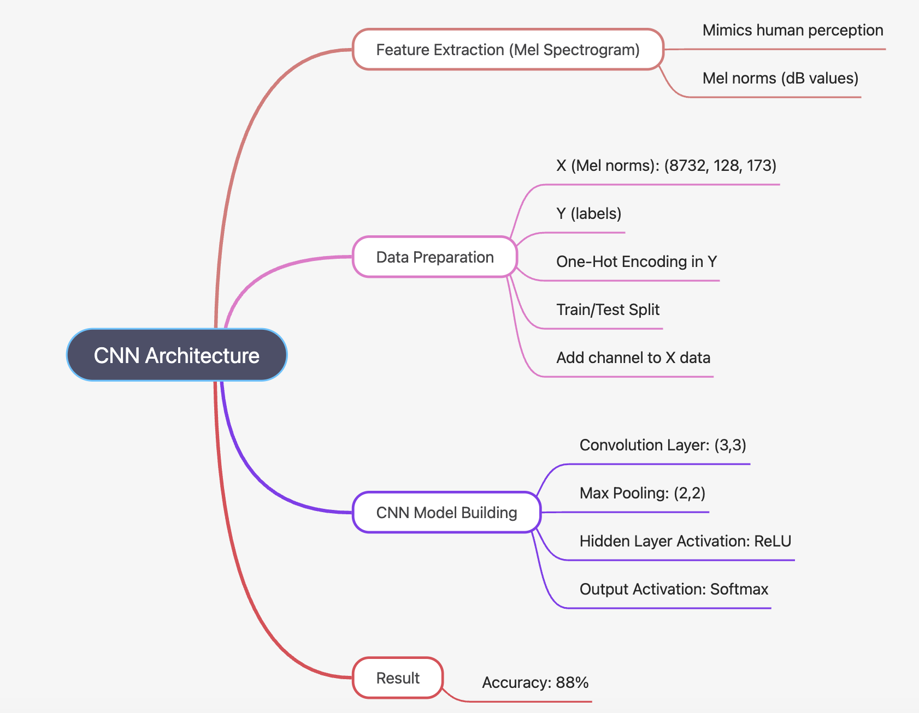
Work Flow Diagram

Slide 8
Methodology
Steps | Description | Tools/Technologies
1. Data Collection | Use of UrbanSound8K dataset containing 8,732 labeled urban sound clips across 10 classes. | Kaggle, UrbanSound8K
2. Data Preprocessing | Resampling audio to 22 kHz, noise reduction, audio trimming, segmentation, and augmentation for dataset balancing. | Librosa
3. Feature Extraction | Extract audio features like MFCCs, Mel Spectrogram, Chroma, and Zero-Crossing Rate. Features reshaped for CNN spectrogram input. | Librosa, SciPy, MFCC + Delta + Delta2
4. Model Training | Implement and train two deep learning models: ANN model on extracted MFCC feature vectors CNN model directly on Mel Spectrogram images for spatial feature learning | TensorFlow, Keras Models: ANN, CNN
5. Evaluation | Perform accuracy evaluation and compare using confusion matrix and classification reports for both ANN & CNN. | Scikit-learn (Confusion Matrix, Accuracy Score), Matplotlib

Slide 9
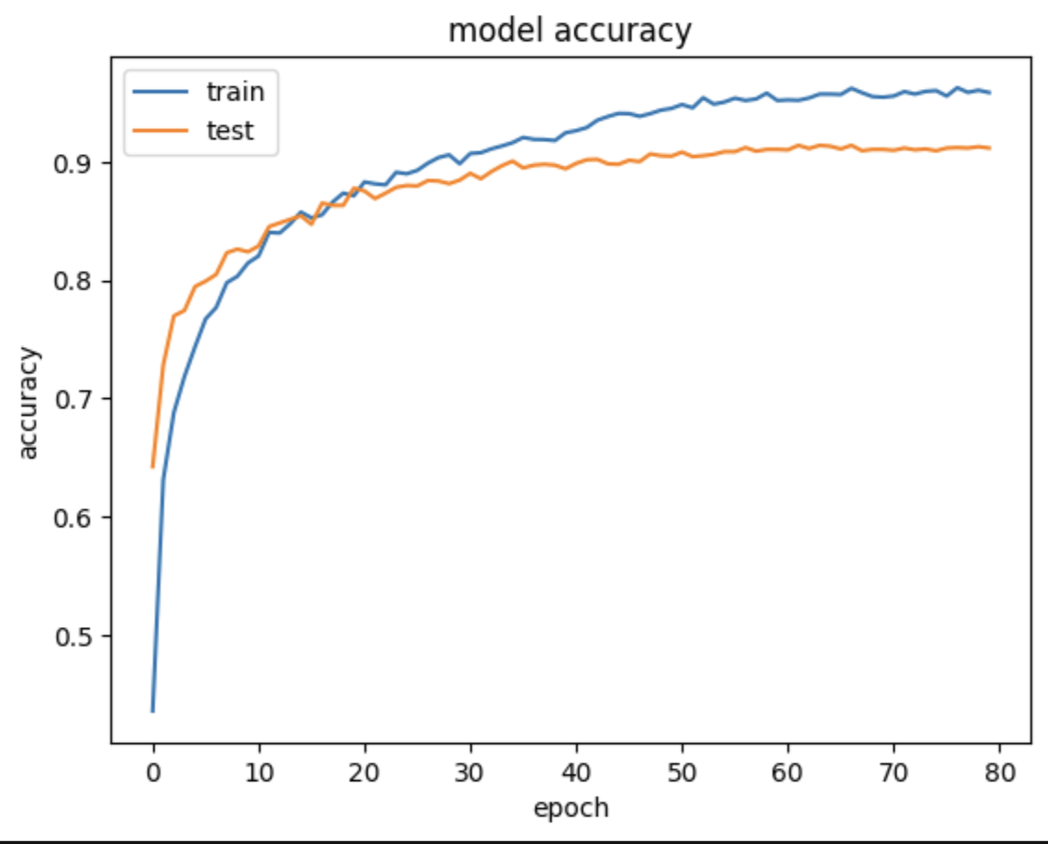
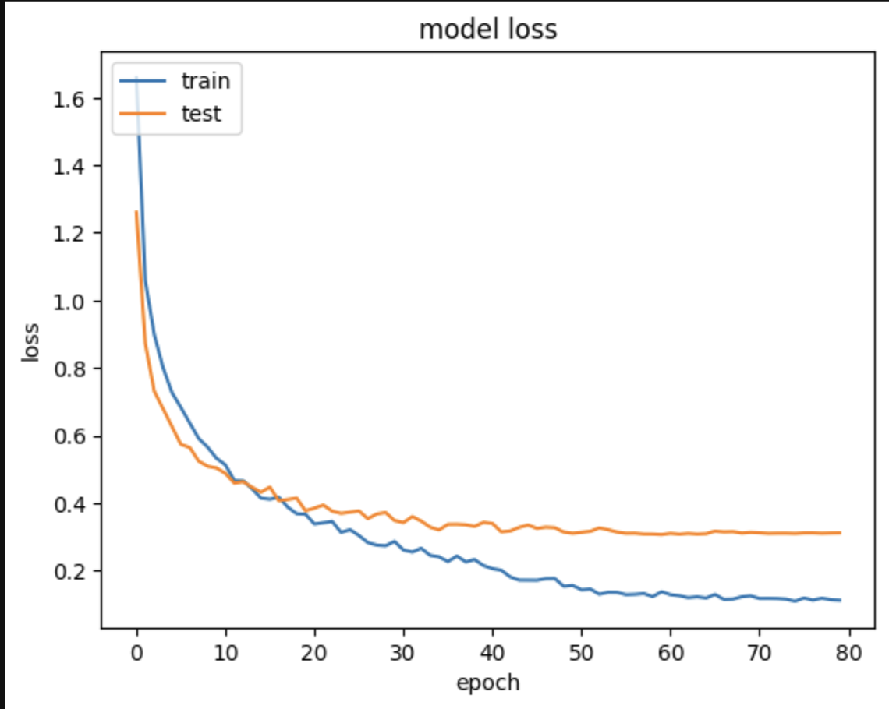
ANN Model – Architecture
Input:
MFCC feature vector extracted from audio clips
Architecture Details:
Dense layer (128 units) + ReLU
Batch Normalization
Dense layer (64 units) + ReLU
Dense layer (32 units)
Output Layer: Softmax (10 classes)
Training Parameters:
Optimizer: Adam
Loss Function: Categorical Crossentropy
Epochs: 50–100
Batch Size: 32
Strengths:
Fast training
Works well with compact feature vectors

Slide 10
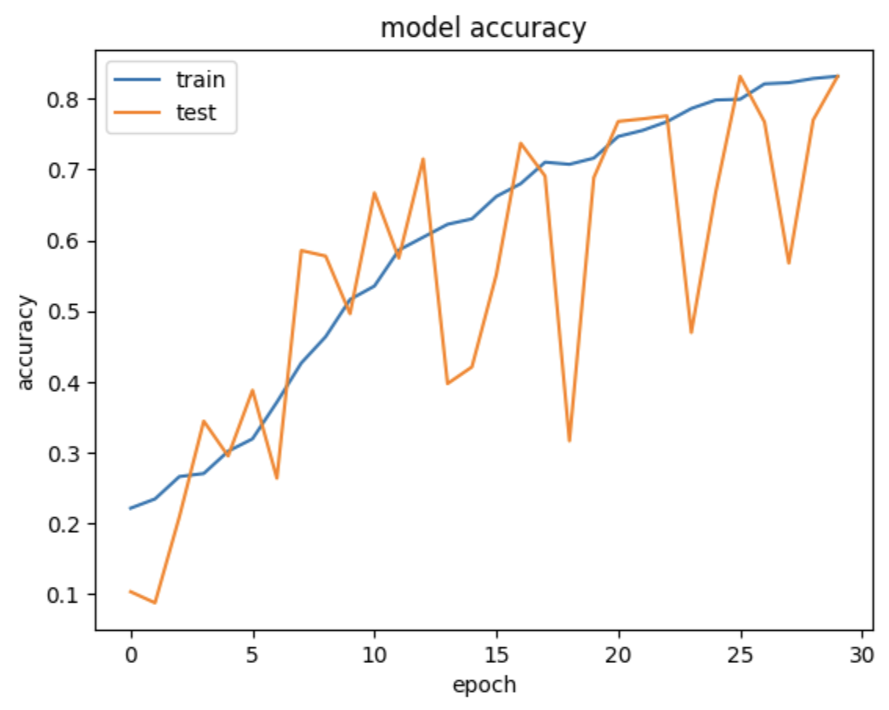
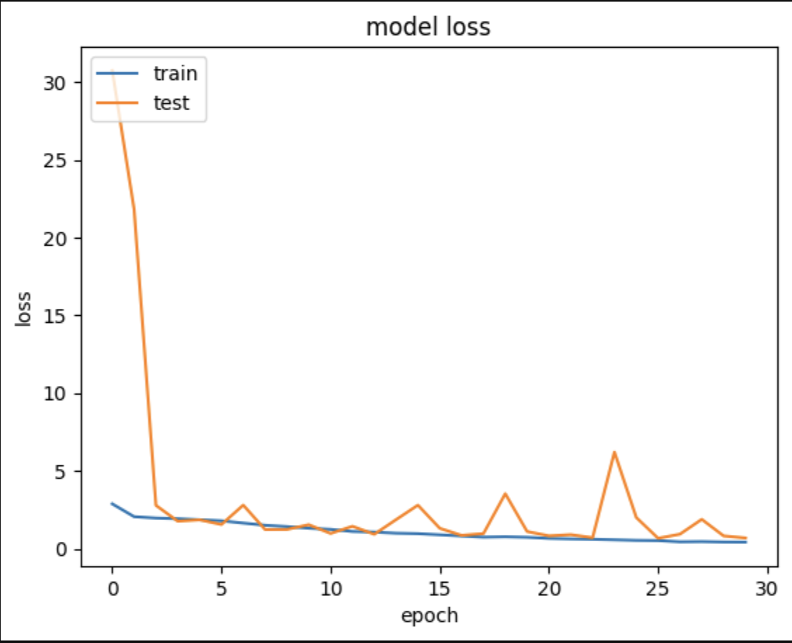
CNN Model – Architecture
Input:
2D Mel-Spectrogram images (converted from audio)
Architecture Details:
Conv2D (32 units) + ReLU + MaxPooling(2, 2)
Conv2D (64 units) + ReLU + MaxPooling(2, 2)
Conv2D (128 units) + ReLU + MaxPooling(2, 2)
Flatten layer
Dense layer (64 units)
Output Layer: Softmax (10 categories)
Training Parameters:
Optimizer: Adam
Loss Function: Categorical Crossentropy
Epochs: 40–60
Batch Size: 32
Advantages:
Learns spatial and frequency patterns
Superior accuracy on complex sound data

Slide 11
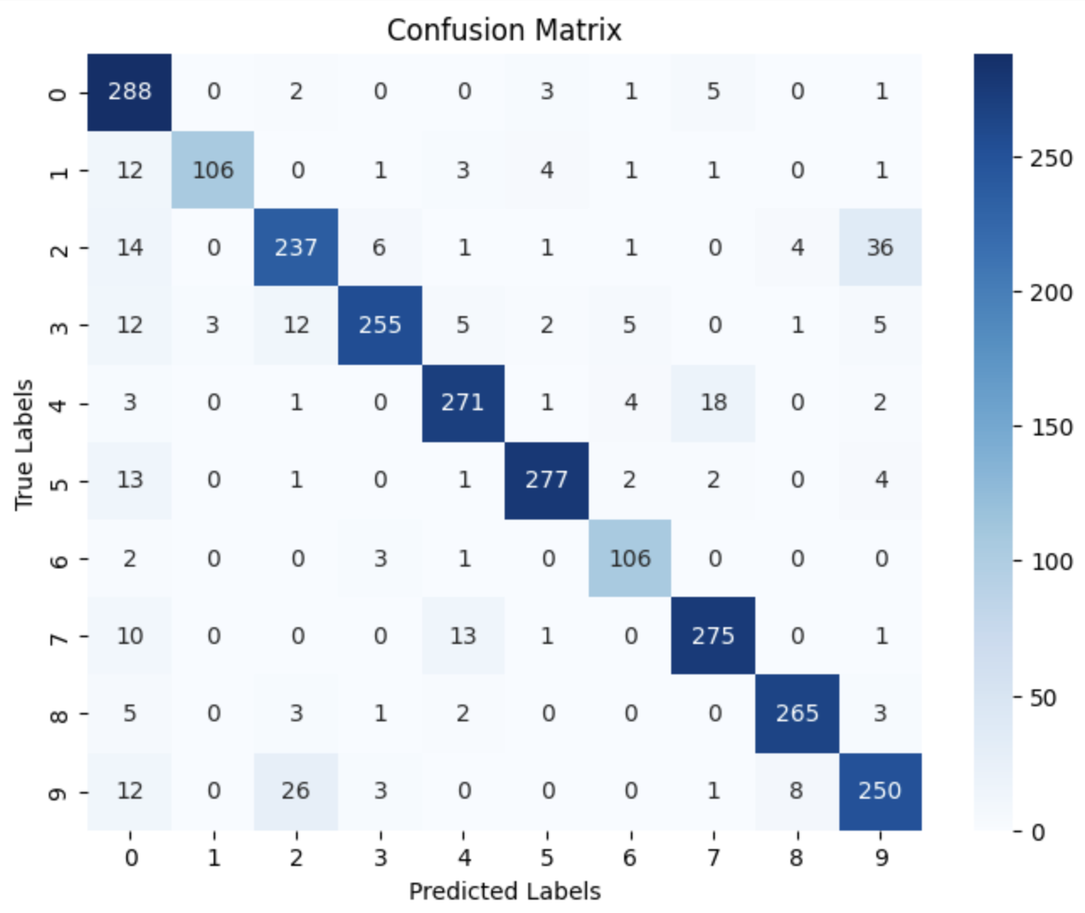
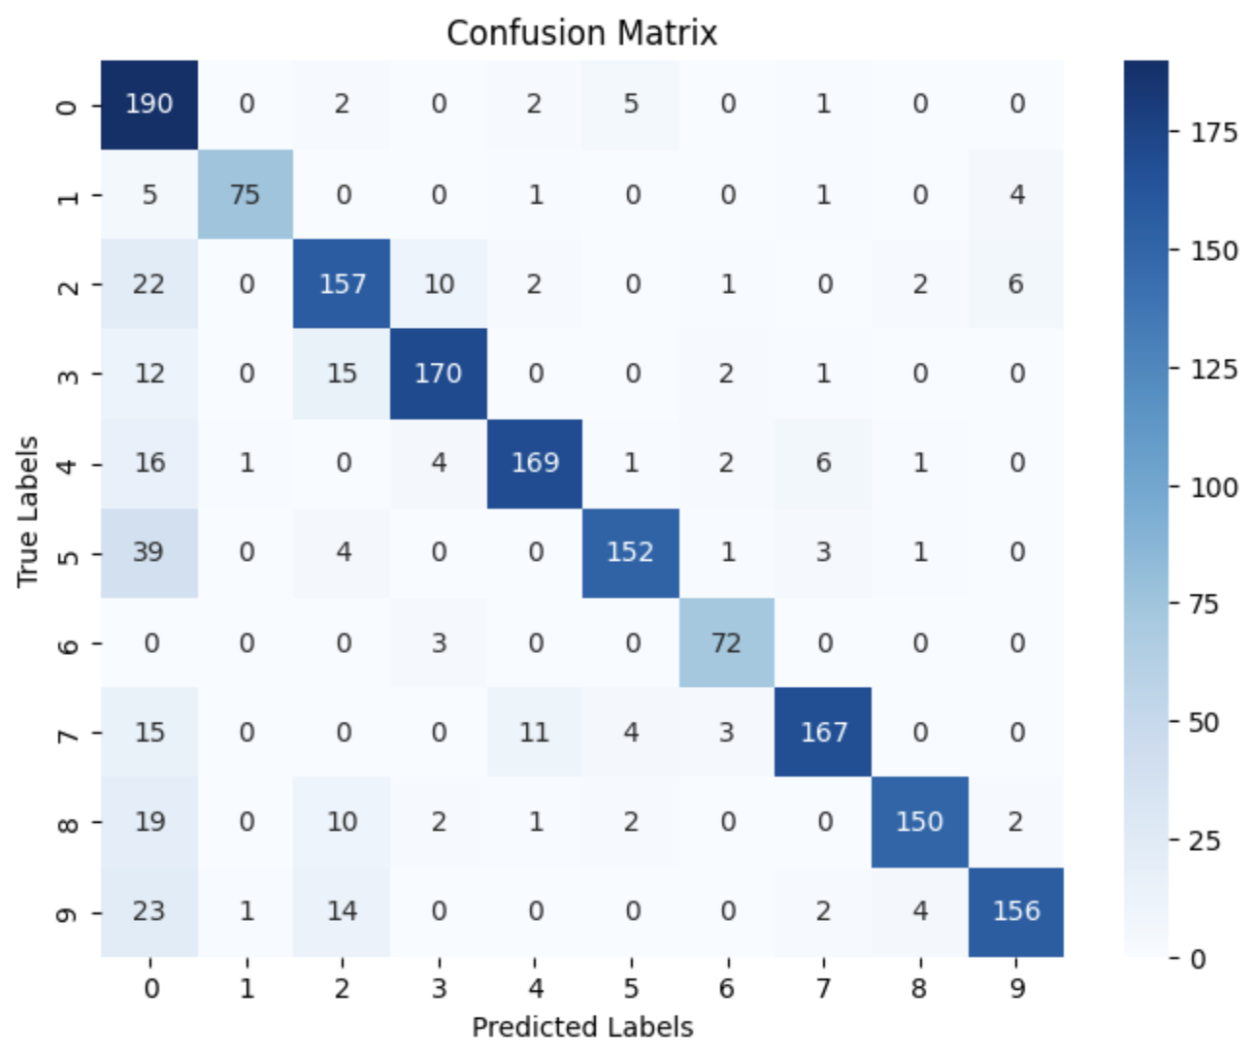
Results Obtained
Accuracy Comparison:
Performance Highlights:
CNN shows higher precision and recall across most sound classes.
ANN performs well for simpler sound categories.
CNN captures advanced temporal-frequency behavior.
ANN Model
Accuracy:- 95.68%
CNN Model
Accuracy:- 84.5%

Slide 12
Contribution
Helps monitor and control urban noise pollution, supporting healthier and more sustainable city environments.
Improves public safety by enabling automatic detection of critical sounds such as sirens, alarms, and accidents.
Supports smart city development through real-time sound analytics that assist in traffic management and incident response.
Enables data-driven urban planning, allowing authorities to design quieter and more optimized city layouts.
Enhances overall quality of life by reducing noise-related stress, protecting sensitive areas like hospitals and schools.

Slide 13
Conclusion and Future Work
The ANN and CNN models effectively classify complex urban sounds, with CNN offering superior recognition due to its ability to learn spatial audio patterns.
The system is suitable for integration into IoT and smart city infrastructures for real-time noise and event monitoring.
Future enhancements include developing a hybrid CNN–LSTM model, RNN & GNN models to capture temporal sound patterns for improved accuracy.
Advanced methods such as Audio Transformers and noise-robust augmentation techniques can further boost performance for real-world deployment.

Slide 14
References
Mushtaq, Z.; Su, S.F. (2020).
Efficient Classification of Environmental Sounds through Multiple Features Aggregation
and Data Enhancement Techniques for Spectrogram Images.
Symmetry, 12, 1822.
Das, J.K.; Chakrabarty, A.; Piran, M.J. (2021).
Environmental sound classification using convolution neural networks with different integrated loss functions.
Expert Systems.
Das, J.K.; Ghosh, A.; Pal, A.K.; Dutta, S.; Chakrabarty, A. (2020).
Urban Sound Classification Using Convolutional Neural Network and Long Short-Term Memory based on Multiple Features.
Proceedings of ICDS 2020.
Mu, W.; Yin, B.; Huang, X.; Xu, J.; Du, Z. (2021).
Environmental sound classification using temporal-frequency attention based CNN.
Scientific Reports, 11, 21552.
McFee et al. (2015).
librosa: Audio and Music Signal Processing Library.

Slide 15
Thank you

